Slide 1



Low Frequency variability of California precipitation
Kaylyn King
Mentor: Dr. Mark Sinclair
Department of Applied Aviation Sciences
Embry-Riddle Aeronautical University, Prescott, Arizona

Slide 2
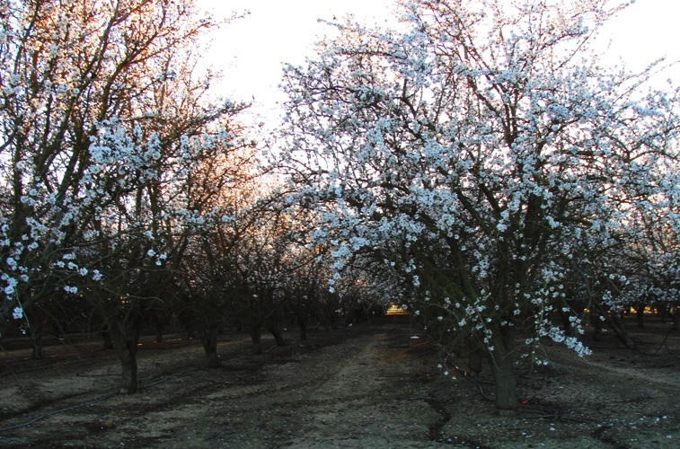
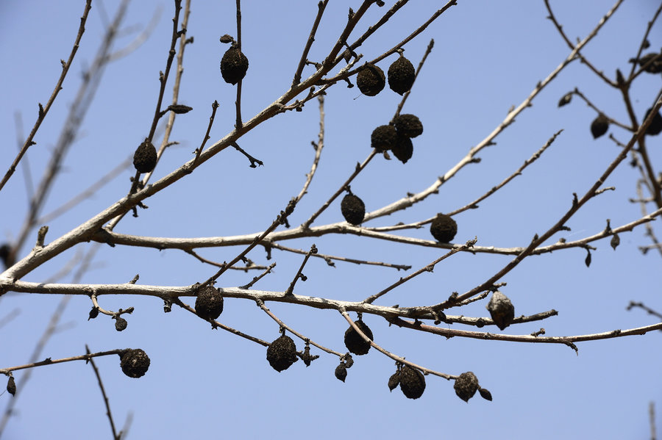
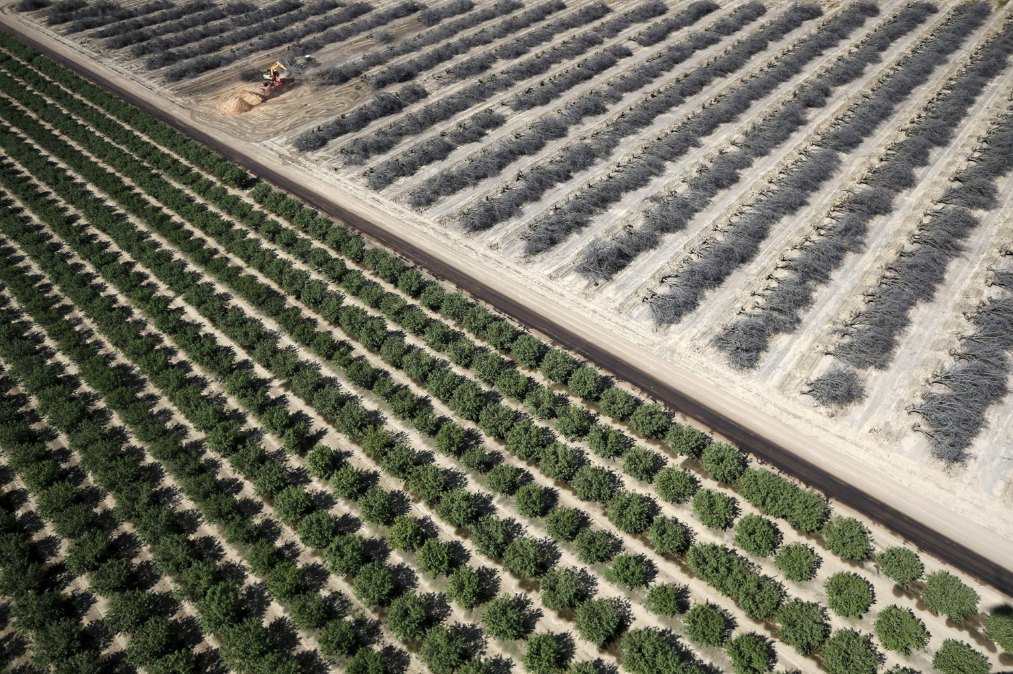
Motivation
This crop has been abandoned due to lack of water
I was raised in a farming community in central California growing up on 40 acres of almonds. Water rationing due to the ongoing drought has greatly reduced profits from the family farm during 2015-2016
Healthy irrigated almonds
Healthy almond trees
Dead almonds
(may they R.I.P.)

Slide 3
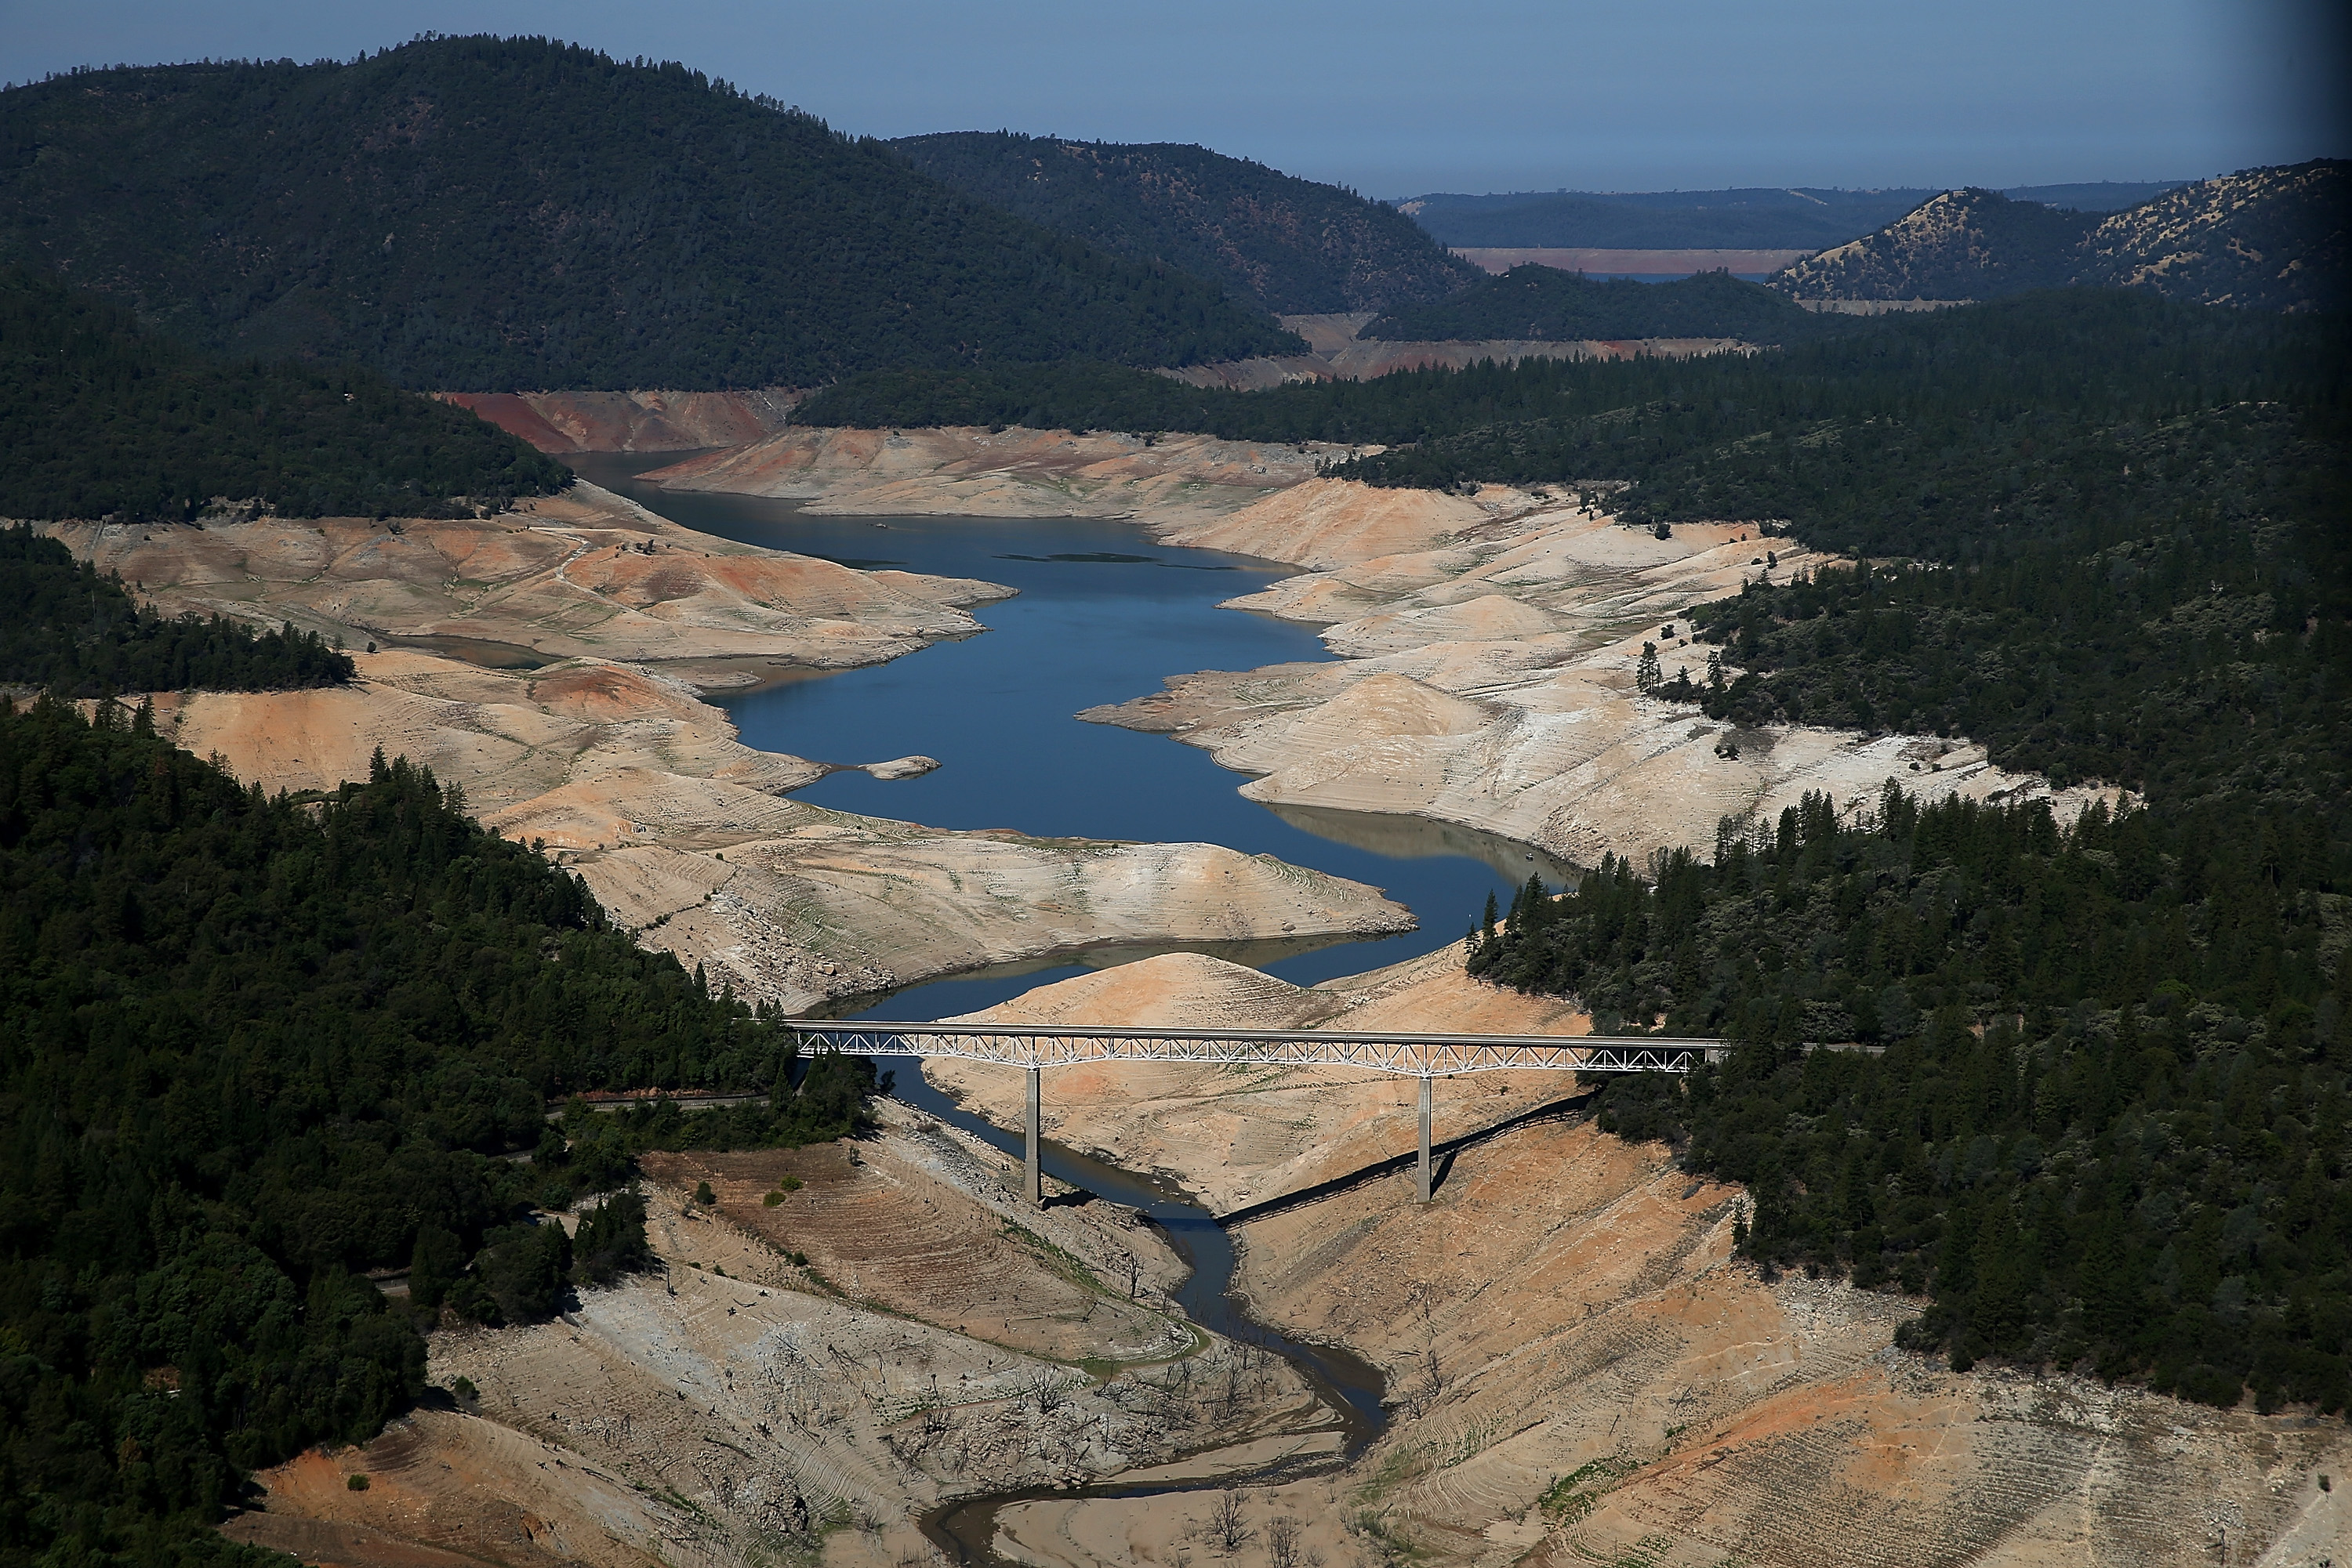
Objective
To understand the influence of the El Niño-Southern Oscillation (ENSO) on the ongoing California drought
Research goals:
Assess strength of El Niño
Compare with previous El Niños
Describe impact on California’s ongoing drought

Slide 4
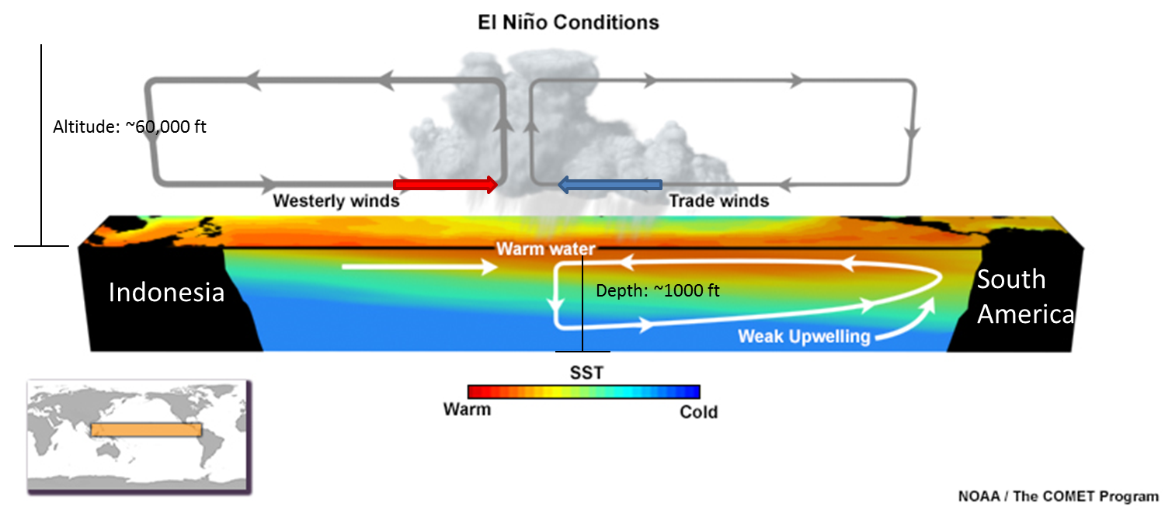
What is el NiÑo?
Abnormal warming of water off the coast of S. America
Notes:
El NIÑo is an abnormal warming of the tropical east Pacific, caused by a reduction of the easterly trades winds, that allows water to “slosh back toward S. America, choking off the cold upwelling.

Slide 5
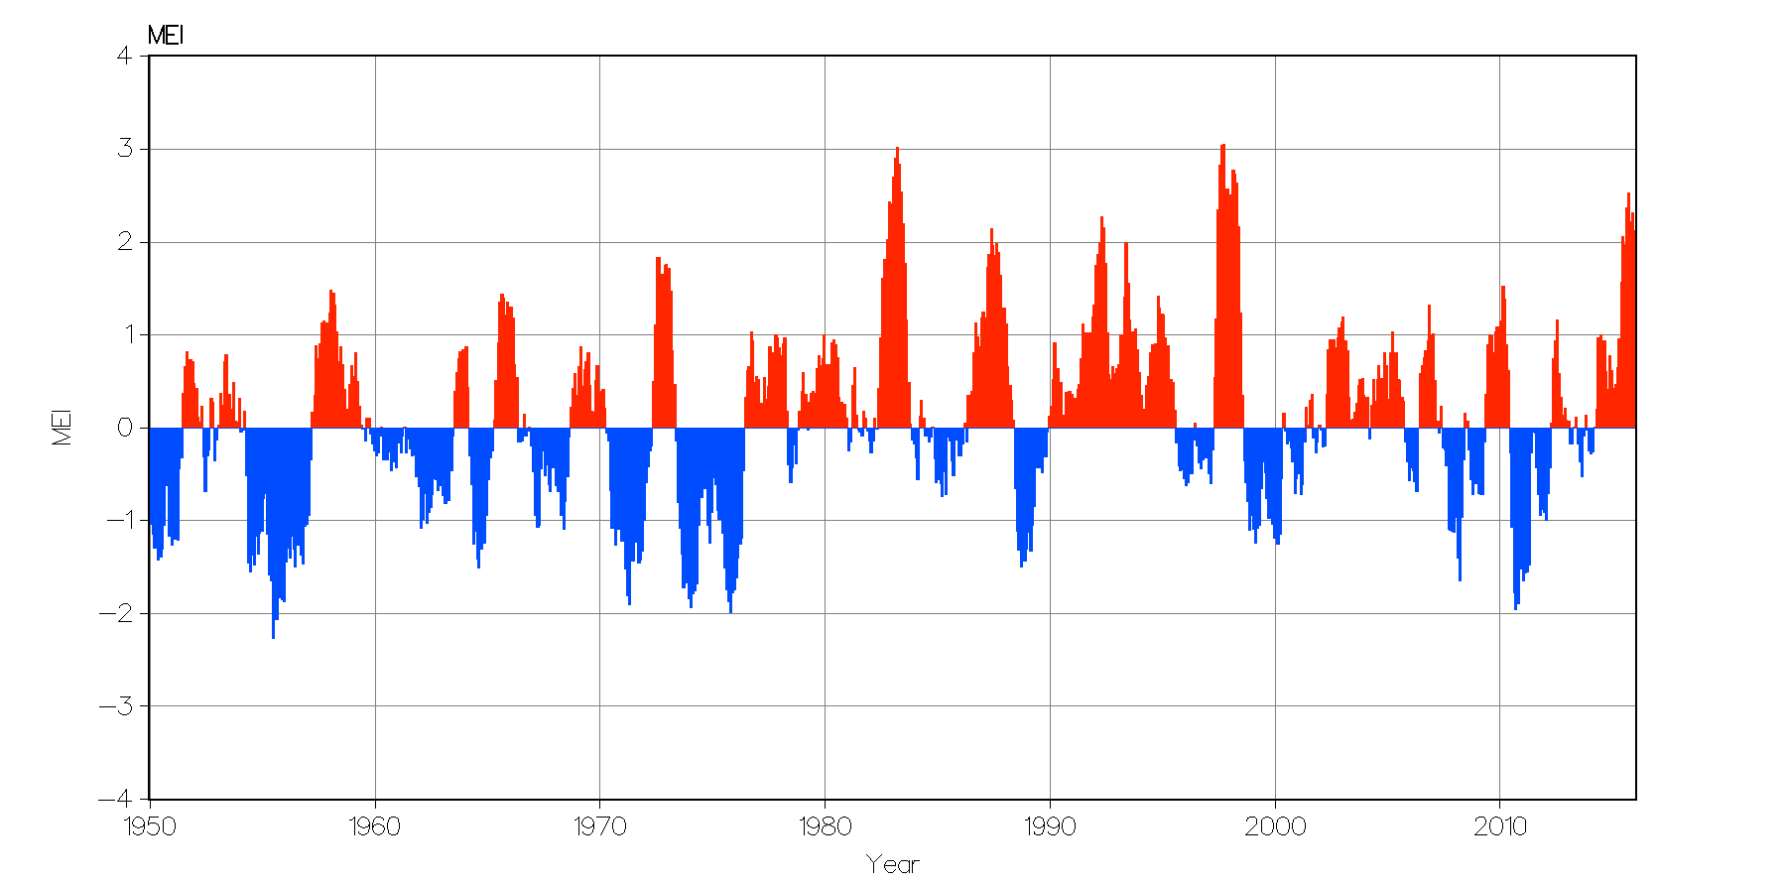
Enso has two phases – El NIÑo & La Niña
ENSO index
Current El Niño
1983
1998
The current El Niño almost as strong as the past two strongest El Niños
Red = El Niño Blue = La Niña
Notes:
The current El Niño is comparable to the previous two record El Niños

Slide 6
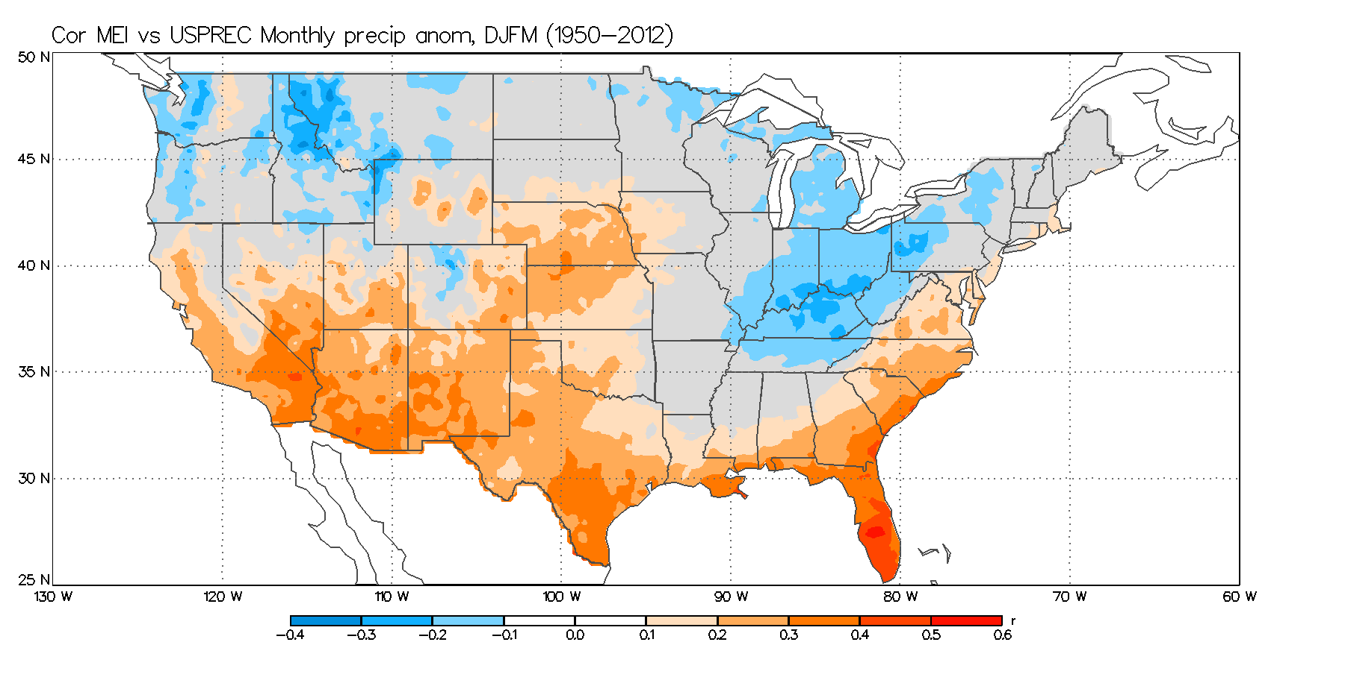
Impact of enso on US precipitation
Correlation between ENSO index and 0.25⁰ resolution US precipitation dataset
Red means wet during El Niño and dry during La Niña
Blue means wet during La Niña and dry during El Niño
Notes:
Explain that during El Niño, it is wetter than normal across the southern tier of the US. This includes south and central CA

Slide 7
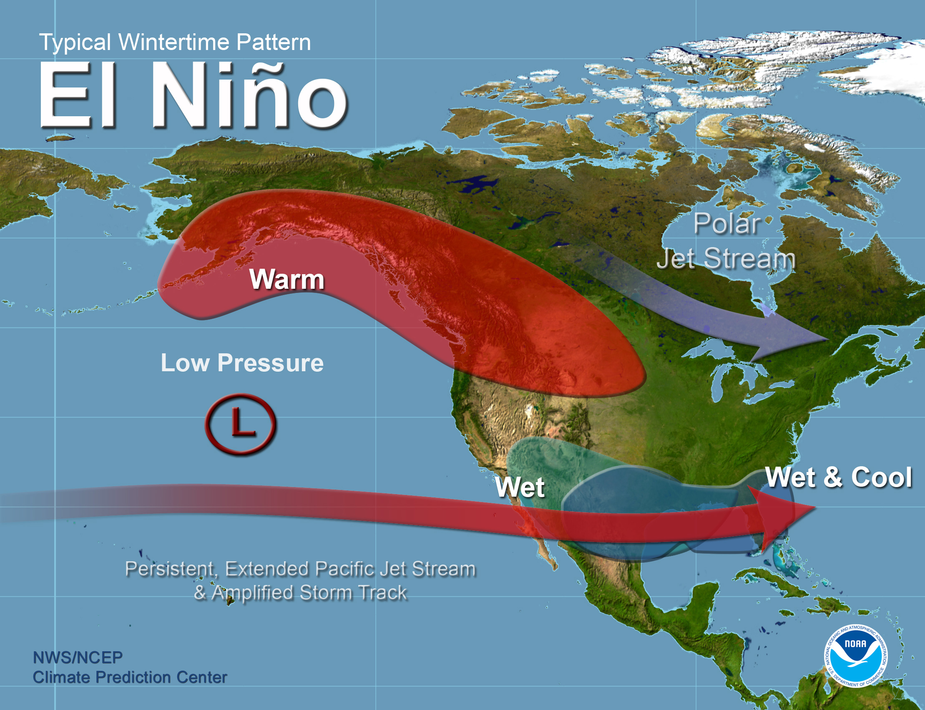
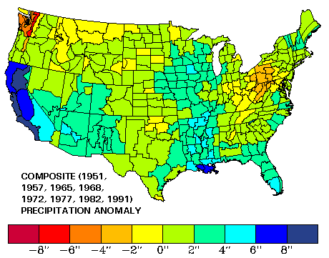
Normal El NiÑo impacts
Notes:
Note wetter than normal years across the south during El Niño. SST anomalies (departures from normal) for Dec 2015. Based on past El Niños, most of CA should receive above normal precip during El Niño.

Slide 8
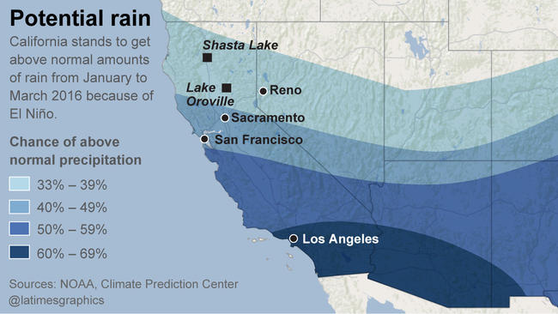
The official forecast for CA, made in DEC 2015
Did this happen?
Or was this El No-show

Slide 9
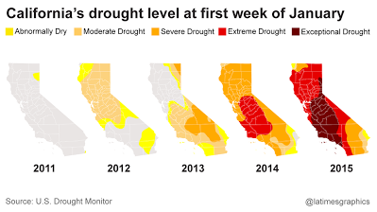
The current California drought

Slide 10
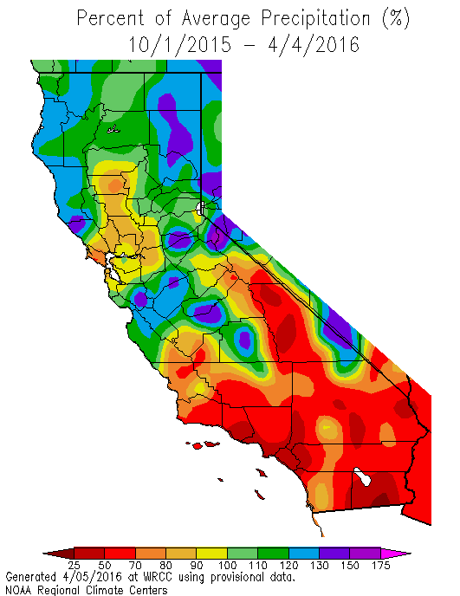
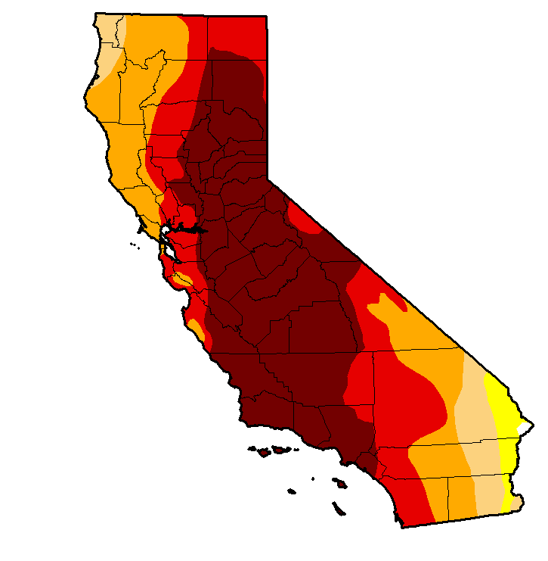
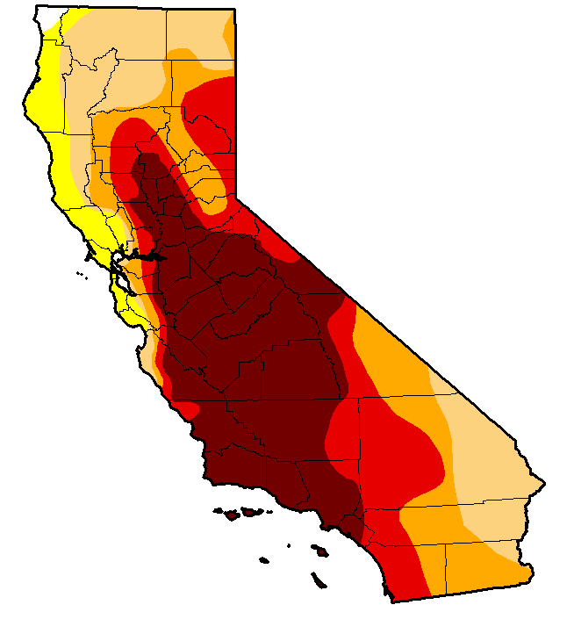
Enso effect on California drought
Dec 15, 2015
March 15, 2015
http://droughtmonitor.unl.edu/
http://gacc.nifc.gov/
Notes:
Slight reduction in drought in N CA

Slide 11
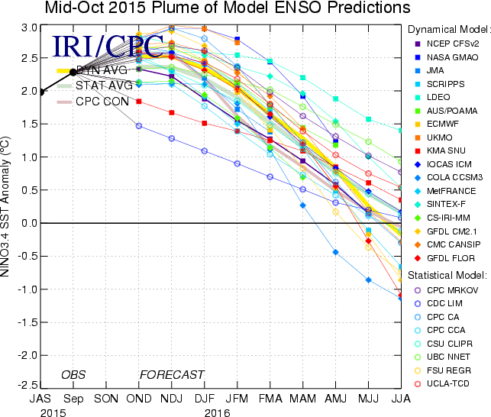
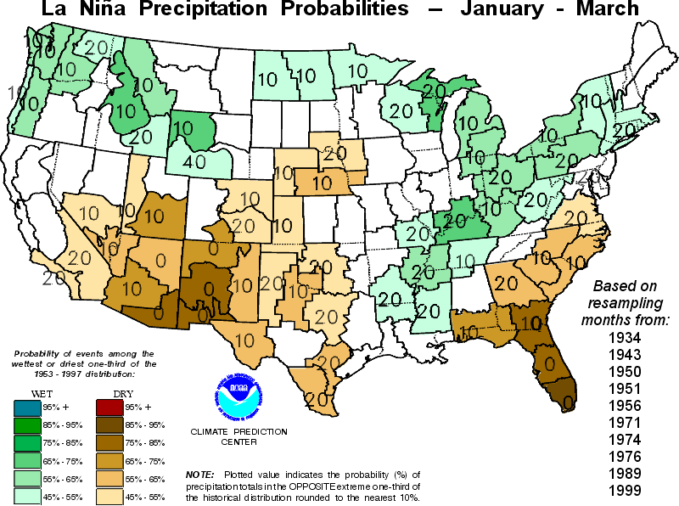
Enso and the future

Slide 12
Conclusion
Current El Niño close to the strongest on record
Drought levels were slightly reduced in Northern California
Expected enhanced precipitation only occurred in northern California
Southern California precipitation below normal with drought worsening
Notes:
Southern California missed getting precipitation with worsening drought there

Slide 13
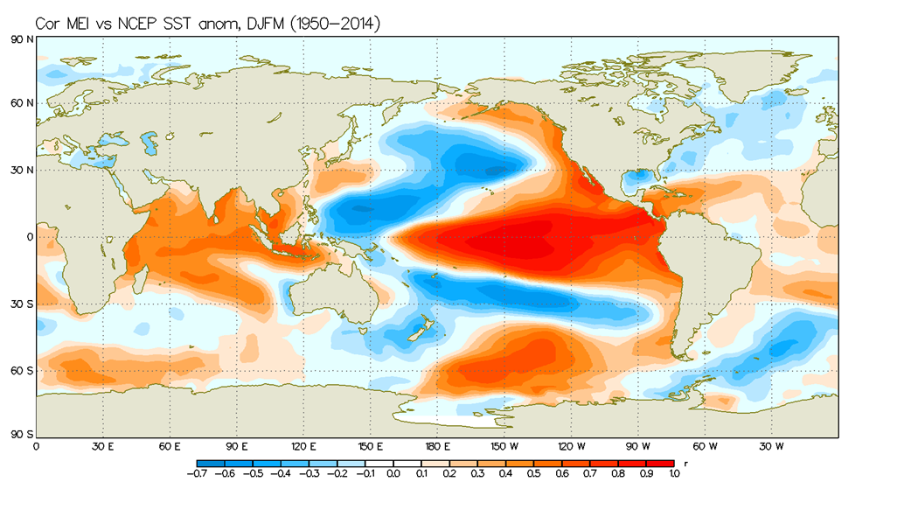
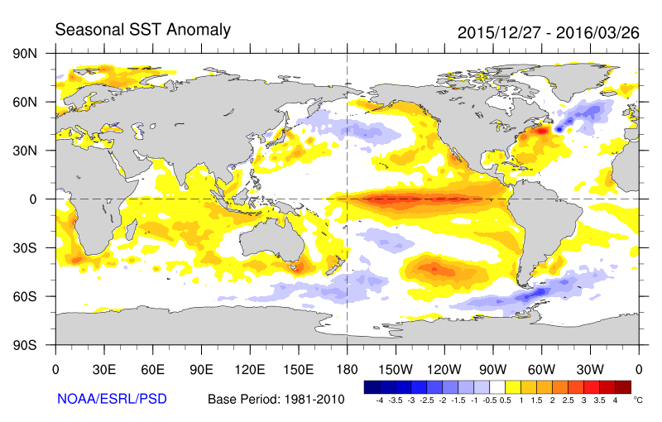
Why less precip during current el Niño?
Hypothesis: Storms like to form near jet streams
Jet streams favor enhanced horizontal temperature gradients
Normal El Niño SST anomaly pattern
Current El Niño SST anomaly pattern

Slide 14
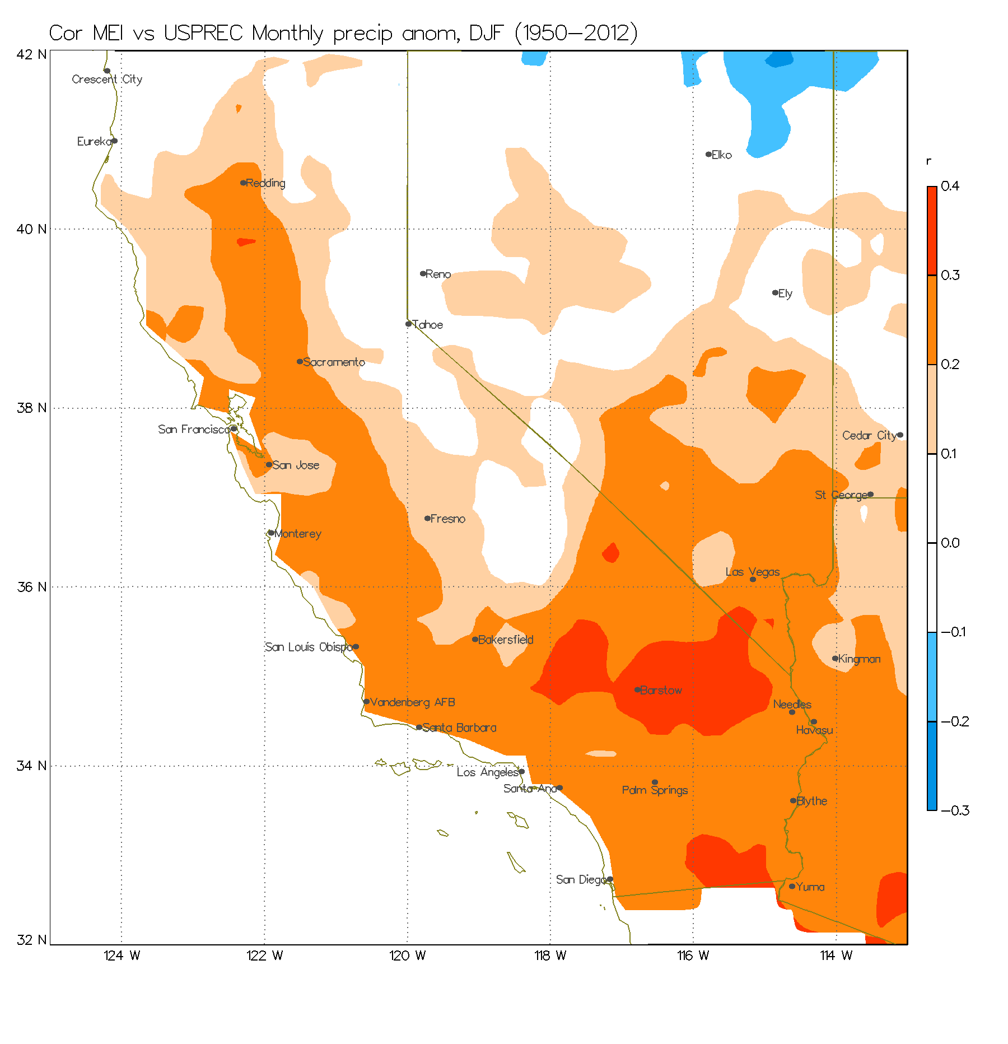
ENSO and precipitation - California
Red means enhanced precip during El Niño and reduced during La Niña
Blue means enhanced precip during La Niña and reduced during El Niño

Slide 15
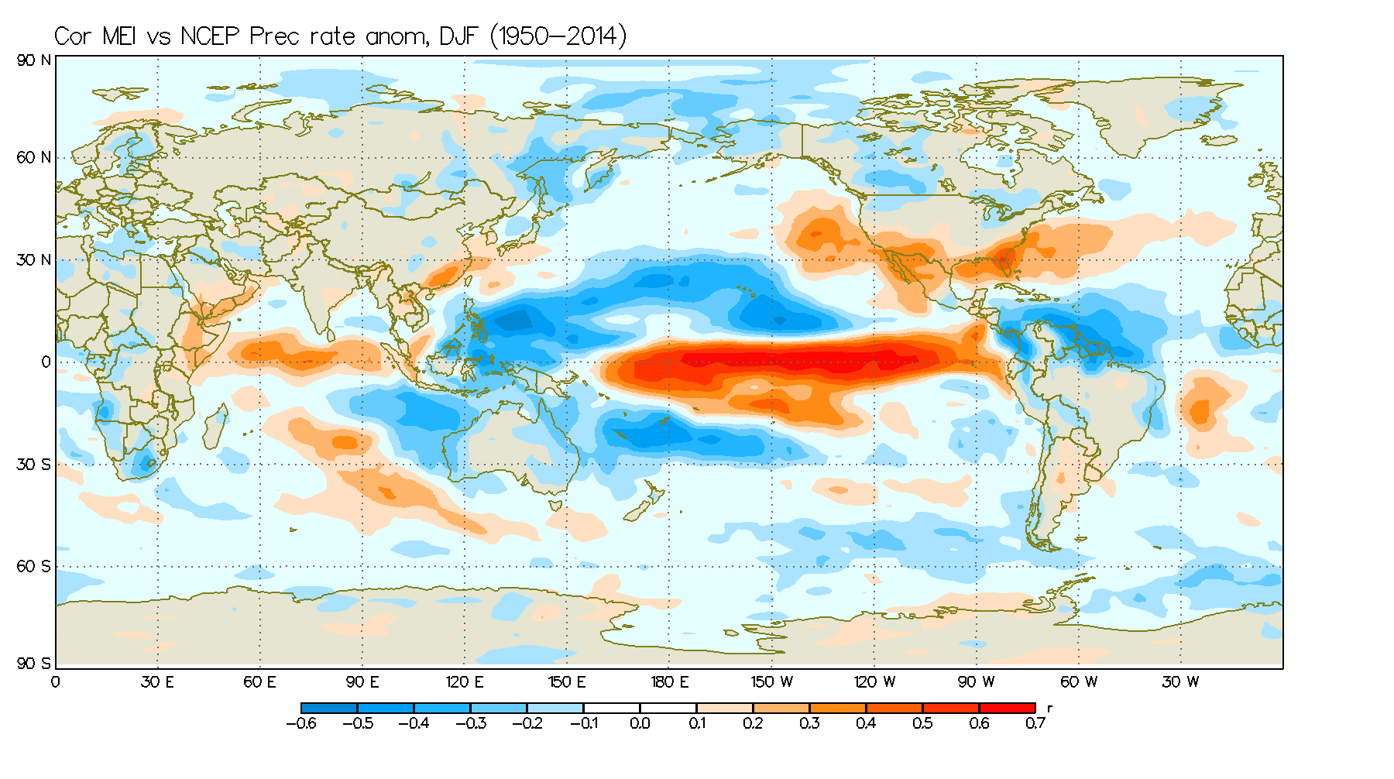
ENSO and precipitation
Red means enhanced precip during El Niño and reduced during La Niña
Blue means enhanced precip during La Niña and reduced during El Niño

